Slide 1

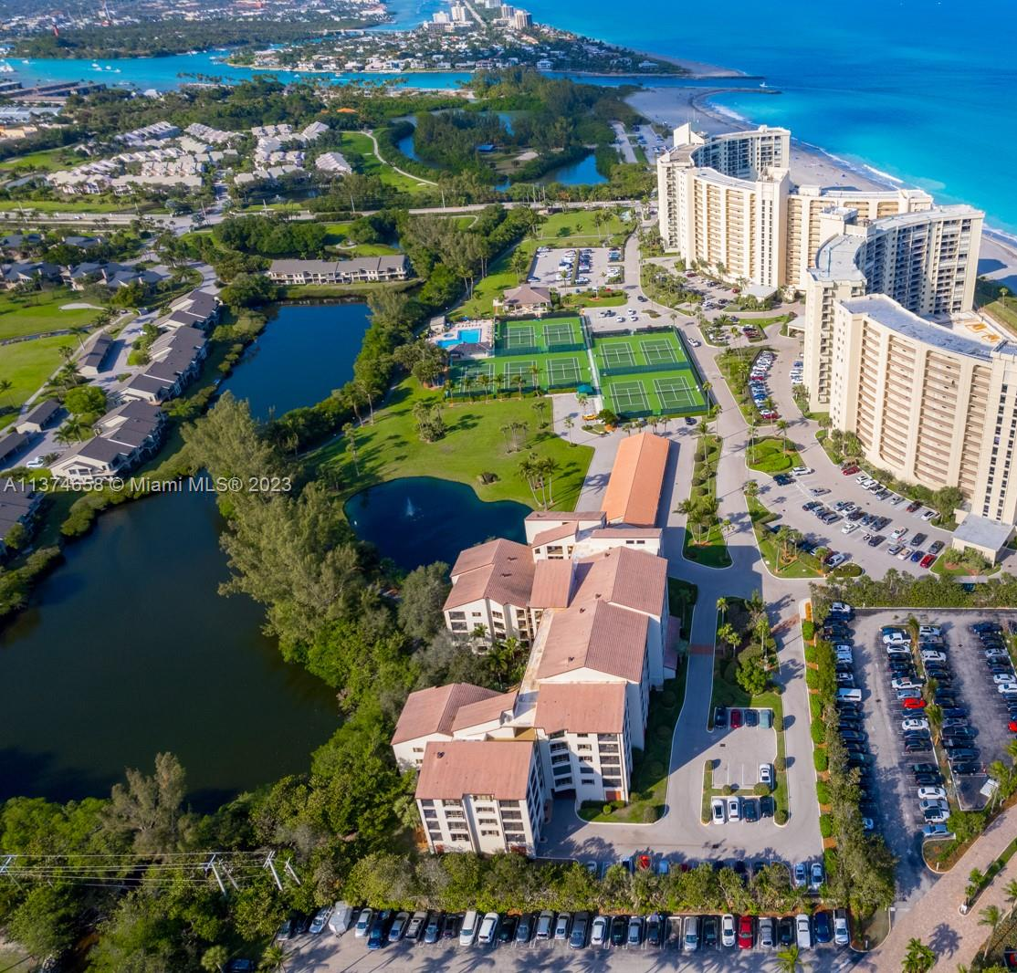
OCEAN TRAIL V
CONCRETE REPAIR / MILESTONE PROJECT
March 6, 2025

Slide 2


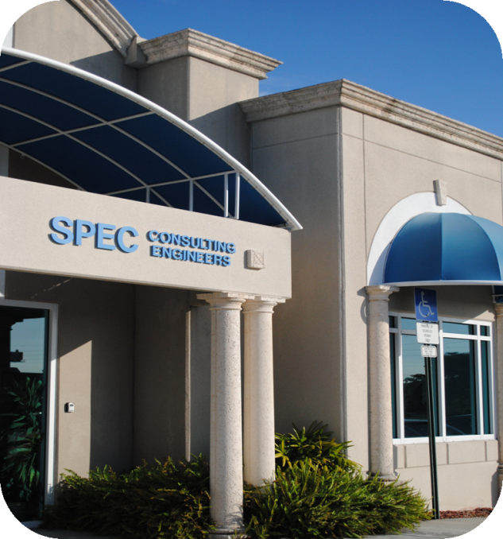
ESTABLISHED IN 1990 TO ASSIST IN A WIDE VARIETY OF BUILDINGS AND CONSTRUCTION PROBLEMS
WE HAVE WORKED ON THOUSANDS OF CONDOMININUMS IN SOUTH FLORIDA PERFORMING BUILDING EXTERIOR CONCRETE REPAIR PROJECTS, PARKING GARAGE CONCRETE REPAIR. WATERPROOFING PROJECTS, PAINTING, WINDOW REPLACEMENTS, RBUILDING SAFETY INSPECTIONS AND MILESTONE INSPECTIONS INSPECTION
Inspection |  | Report |  | Specifications |  | Bids |  | Construction

Slide 3
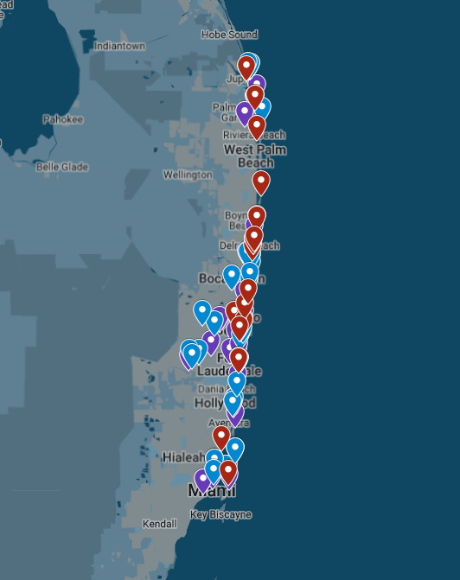
ENGINEERING FIRM BACKGROUND
ON-GOING WORK INCLUDES APPROXIMATELY 110 PROJECTS AT VARIOUS STAGES OVER THREE (3) COUNTIES.
PROJECTS RANGE FROM $10,000 SIMPLE RESTORATION PROJECTS TO OVER $9,000,000 DOLLAR MULTI-YEAR RESTORATION PROJECTS.
WE ARE WELL-VERSED IN A MULTITUDE OF REPAIR TECHNIQUES AND CAN MAKE MULTIPLE RECOMMENDATIONS FOR PROBLEMS.
WE ARE ABLE TO GIVE YOU A COST/BENEFIT TYPE OF APPROACH TO ENSURE THAT THE MONEY SPENT IS BEING SPENT EFFICIENTLY.

Slide 4
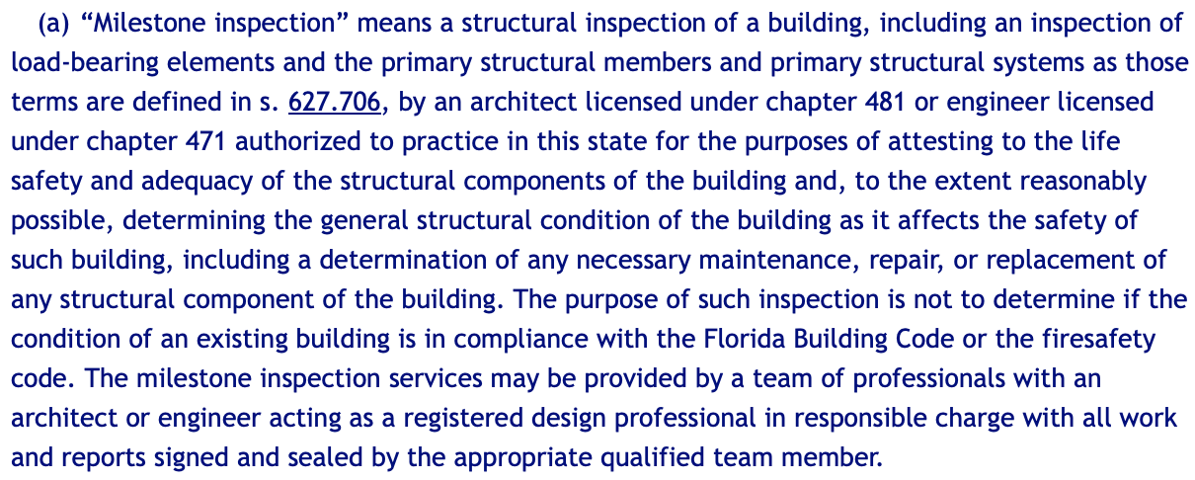
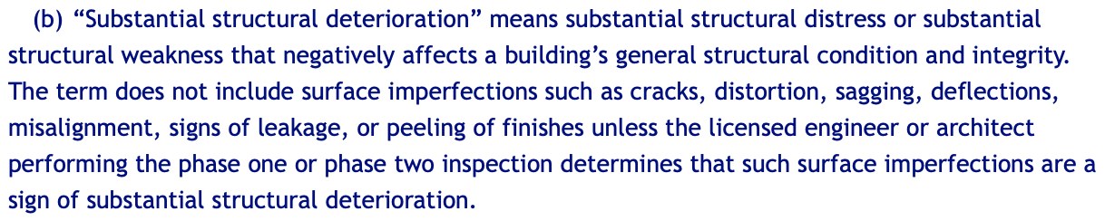
WHY ARE WE HERE?
FLORIDA STATUTES SECTION 553.899 – MANDATORY STRUCTURAL INSPECTIONS FOR CONDOMINIUM AND COOPERATIVE BUILDINGS
LAW PASSED AFTER THE COLLAPSE OF CHAMPLAIN TOWER IN SURFSIDE
MIAMI-DADE COUNTY AND BROWARD COUNTY HAD PREVIOUSLY BEEN DOING A SIMILAR PROGRAM. NOW ENTIRE STATE IS MANDATED TO PERFORM INSPECTIONS AND MAKE REPAIRS

Slide 5
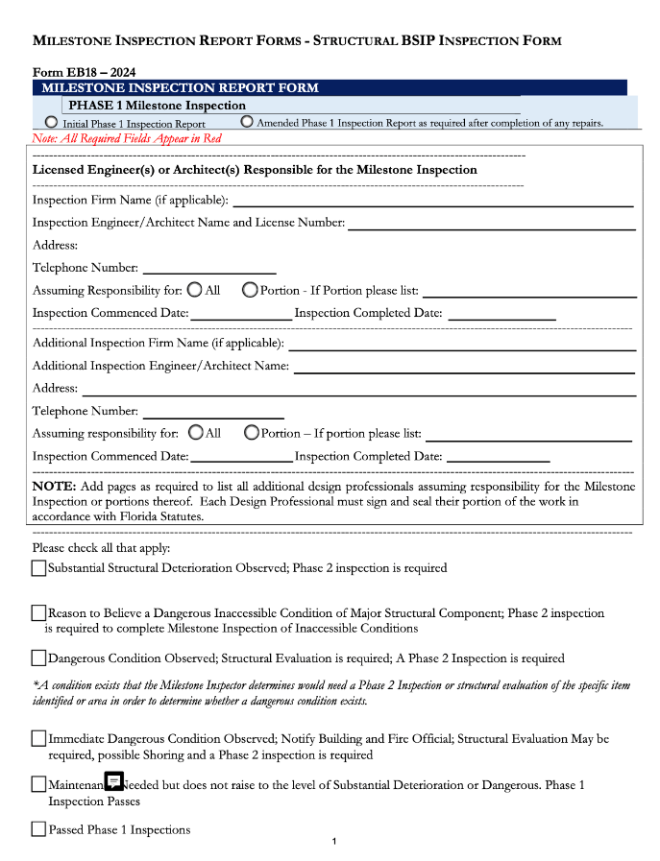
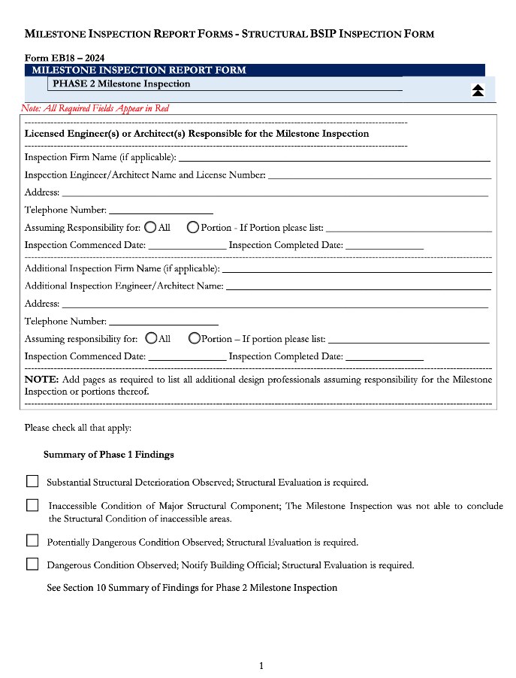
MILESTONE REQUIREMENTS
PERFORM THE INSPECTION WITHIN 180 DAYS OF RECEIVING A NOTIFICATION FROM THE BUILDING OFFICIAL
PHASE I / PHASE II REPORT
SAFE/UNSAFE
REPAIRS REQUIRED
IF SUBSTANTIAL STRUCTURAL DAMAGE, REPAIRS TO BE COMMENCED WITHIN 365 DAYS RECEIPT OF REPORT
PROCESS IS GOING TO BE REPEATED EVERY 10 YEARS

Slide 6
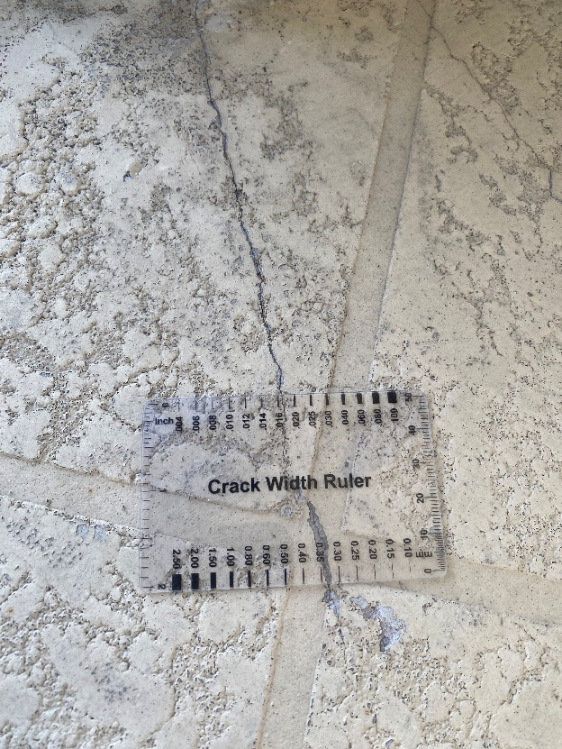
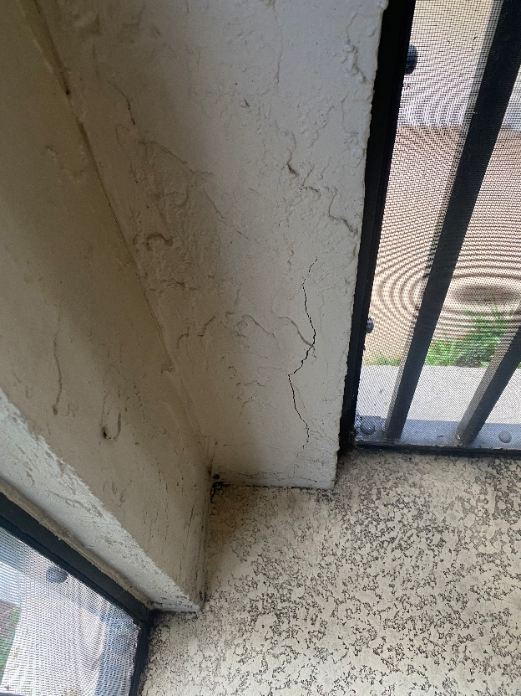
MILESTONE REQUIREMENTS
REPORTS HAVE BEEN SUBMITTED TO THE TOWN OF JUPITER IN DECEMBER 2023; STRUCTURAL REPAIRS ARE REQUIRED IN OUR OPINION
THERE ARE VARYING LEVELS OF REPAIR BASED ON THE BUILDING
ITS AN ALL OR NOTHING IN TERMS OF REPAIRS REQUIRED – EVEN IF THERE IS JUST ONE REPAIR REQUIRED IT TRIGGERS THE SAME AS A BUILDING WHERE THERE IS SIGNIFICANT AMOUNT OF DAMAGE

Slide 7
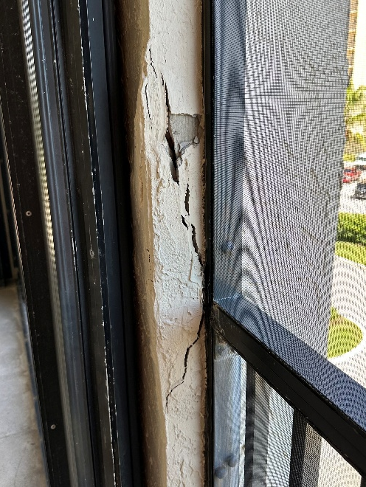
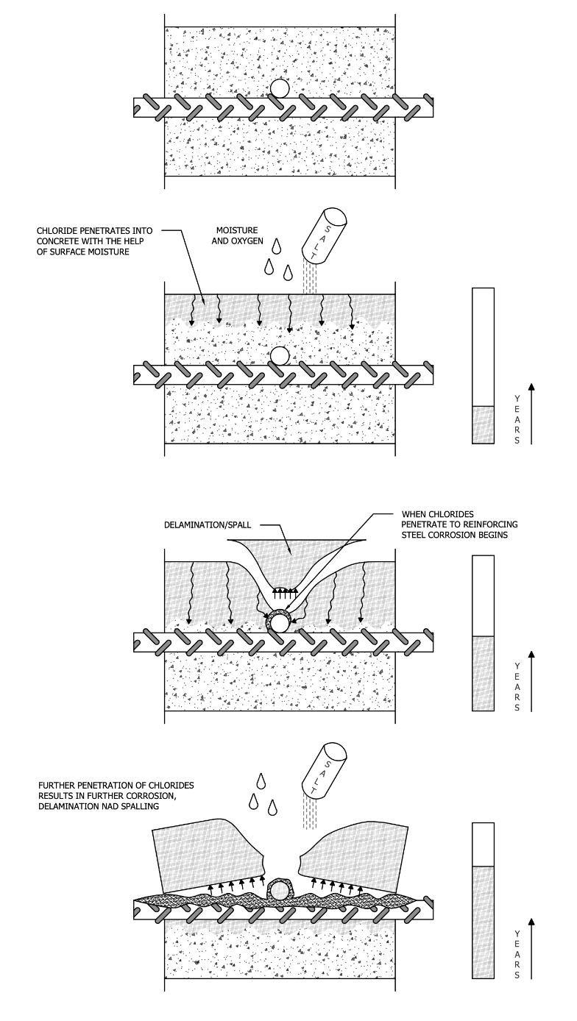
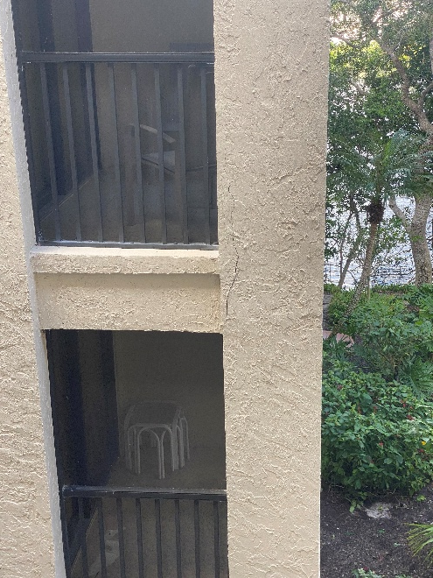
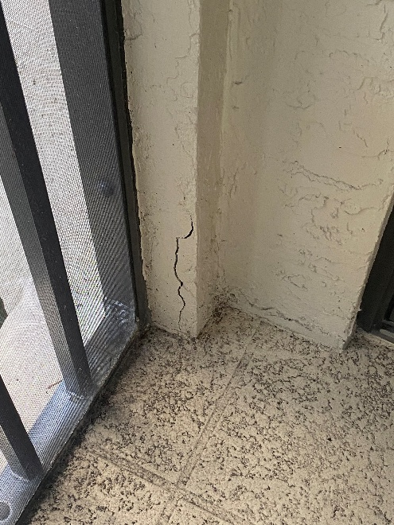
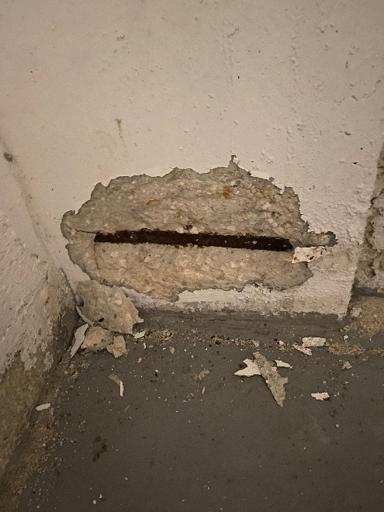
CONCRETE DETERIORATION MECHANISM

Slide 8
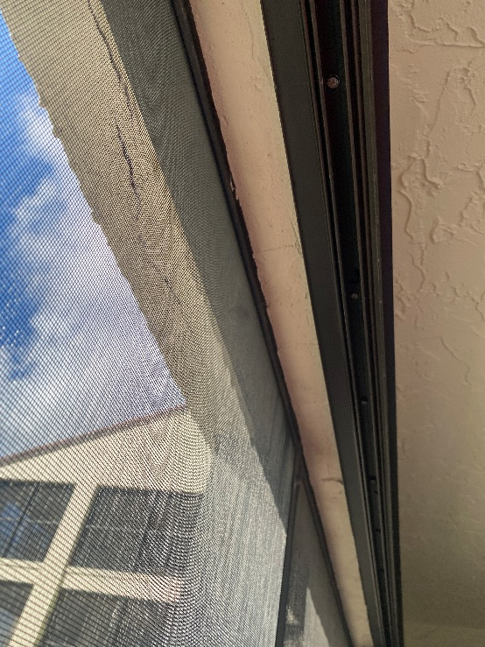
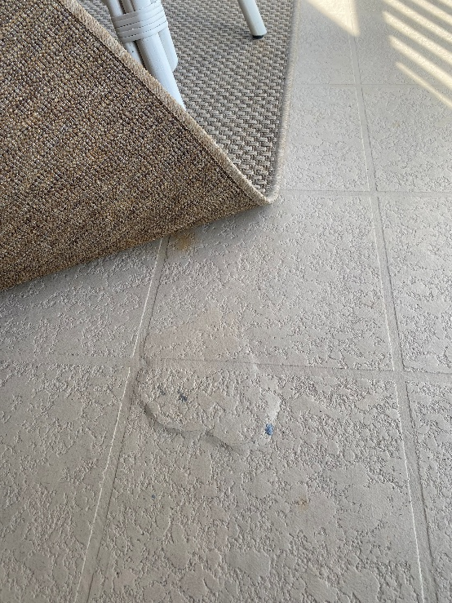
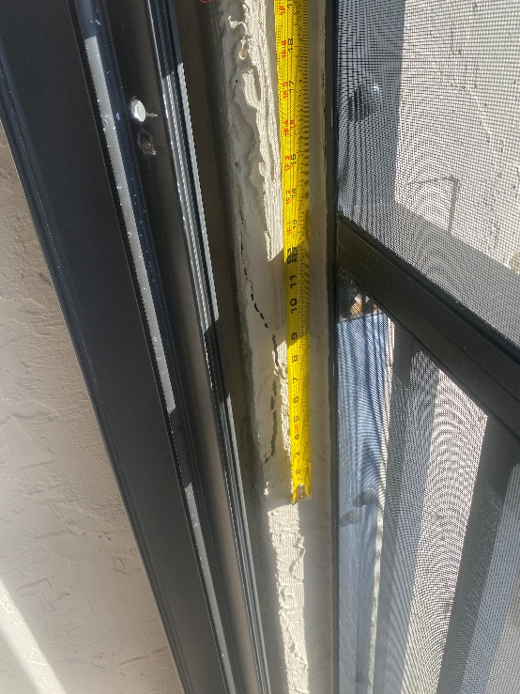
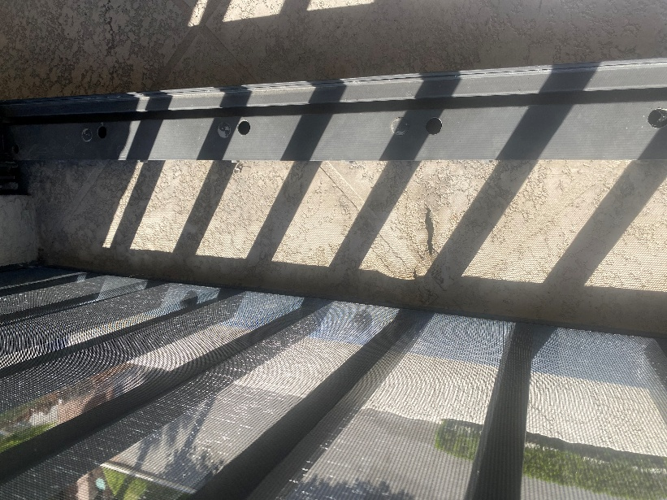
CONCRETE DETERIORATION MECHANISM

Slide 9
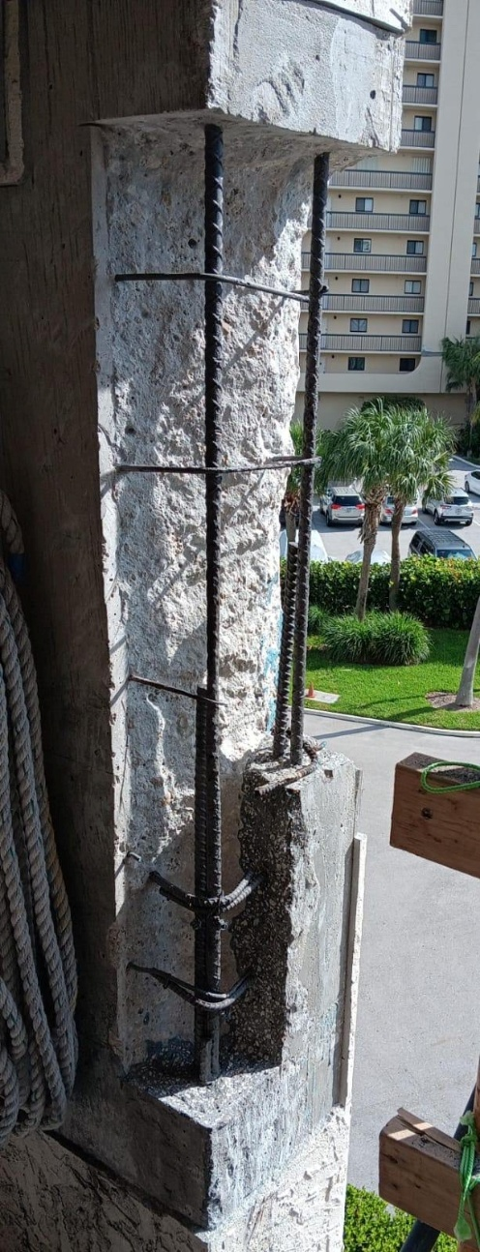
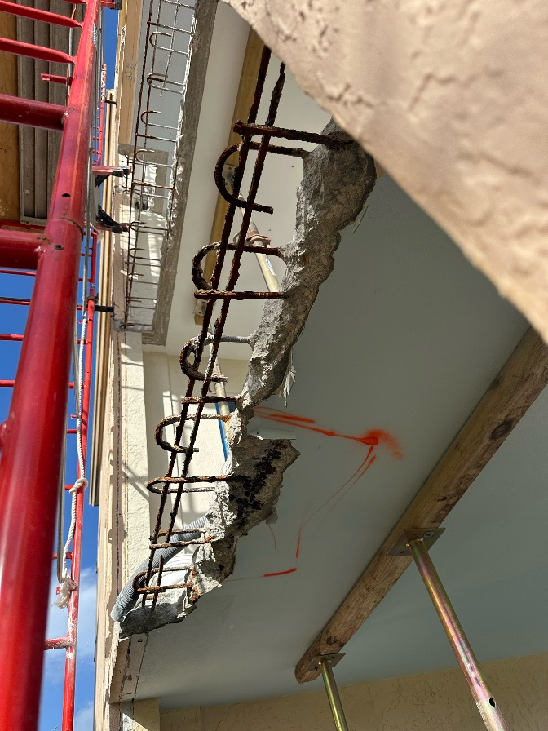
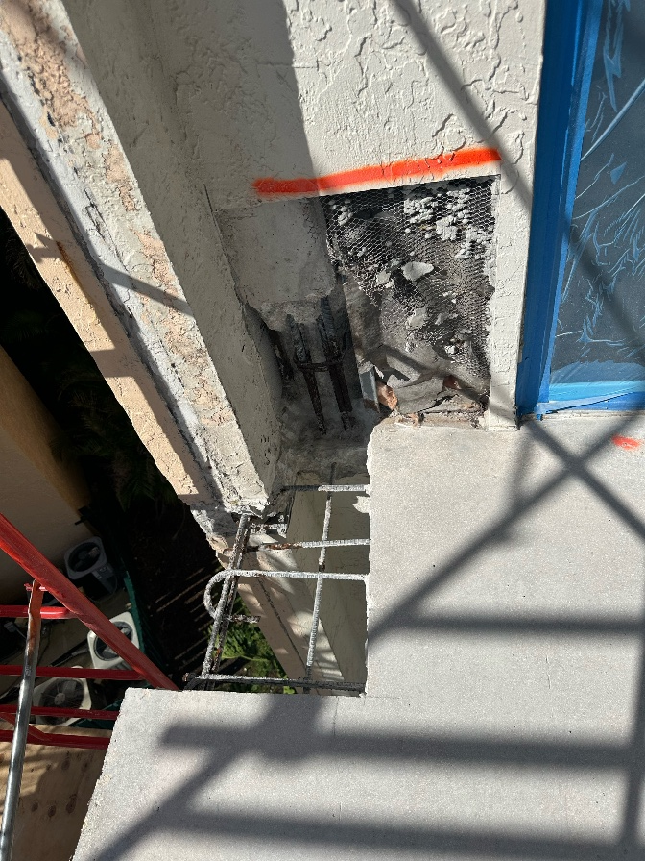
WHAT DO THE REPAIRS LOOK LIKE?

Slide 10
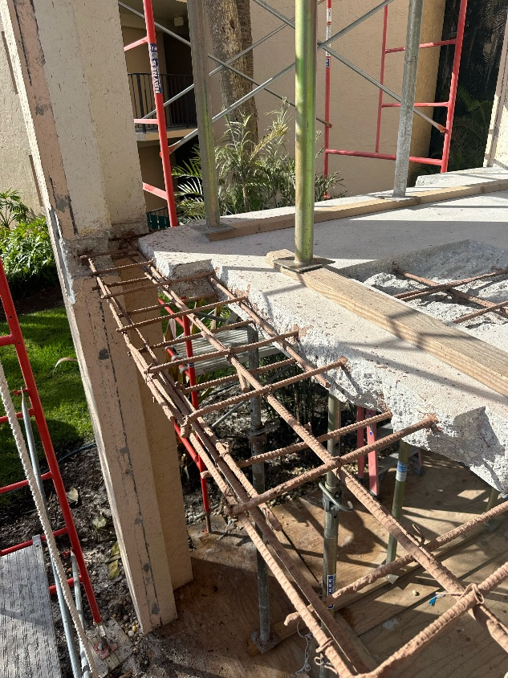
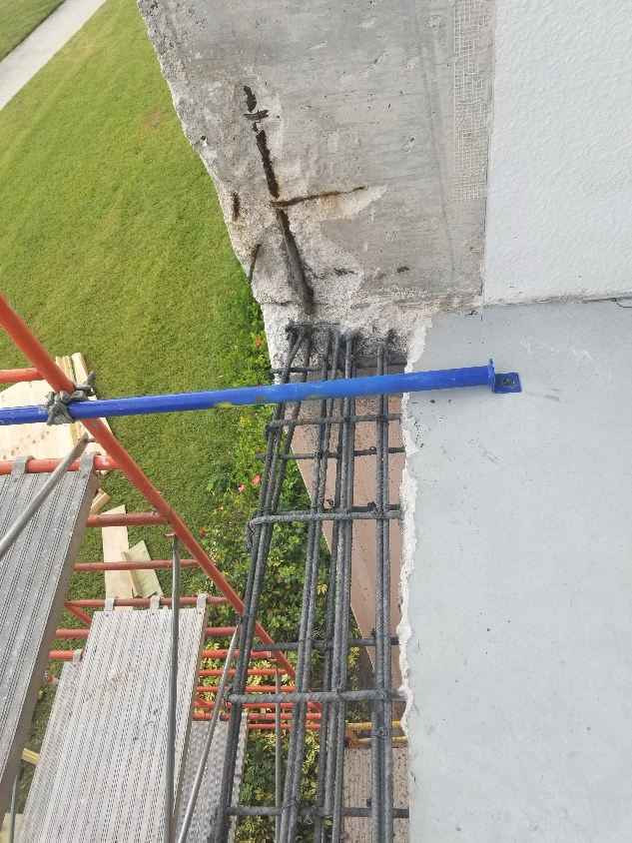
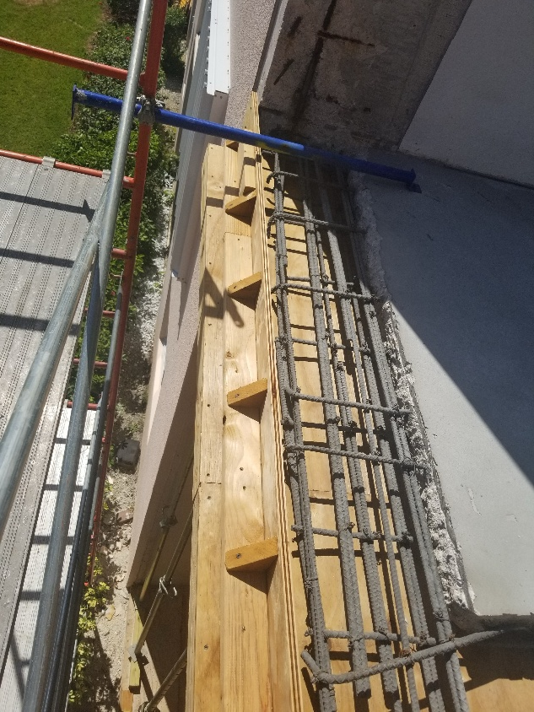
WHAT DO THE REPAIRS LOOK LIKE?

Slide 11
DO WE DO THE BARE MINIMUM TO PASS THE REPORT OR DO WE LOOK AT THE REPAIRS HOLISTICALLY?
YOU MINIMALLY HAVE TO REPAIR ALL THE SUBSTANTIAL STRUCTURAL DETERIORATION (CONCRETE DAMAGE AT THE STRUCTURAL FRAMING SYSTEM)
HOW CAN WE ENSURE WE REPAIR ALL THAT DAMAGE? – REMOVAL OF EXTERIOR FINISHES
ECONOMY OF SCALE TO THE EXTERIOR REPAIR WORK
WATERPROOF COATINGS
NEW SCREEN ENCLOSURES

Slide 12
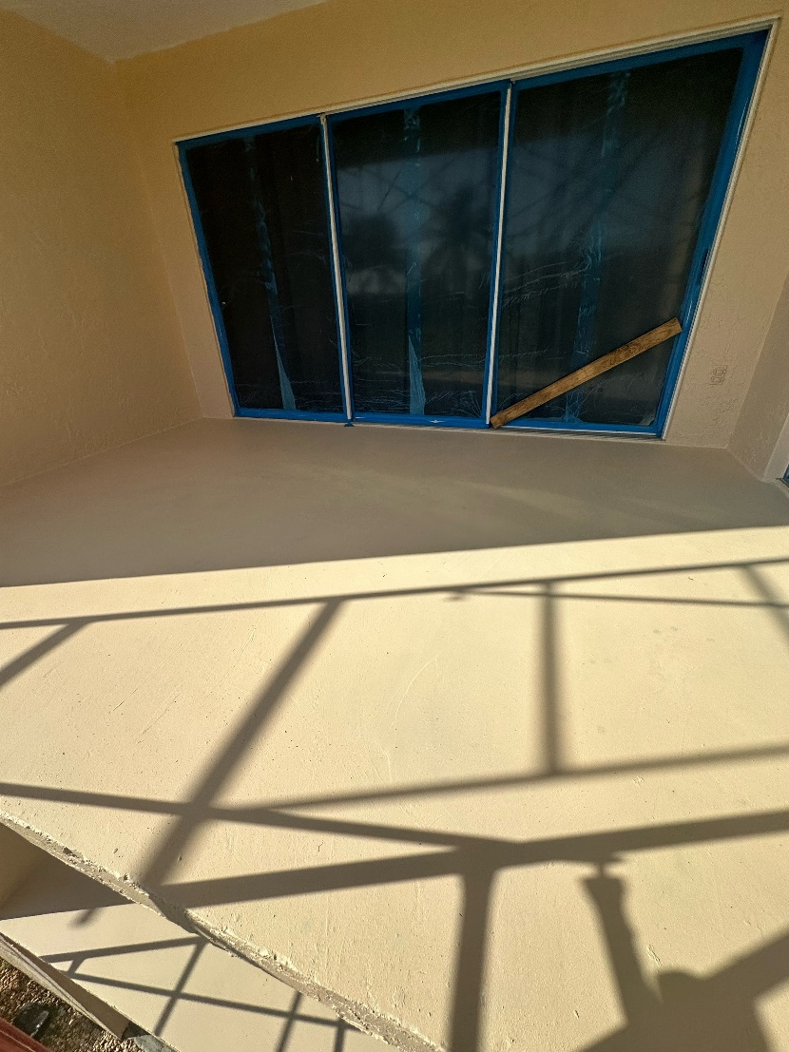
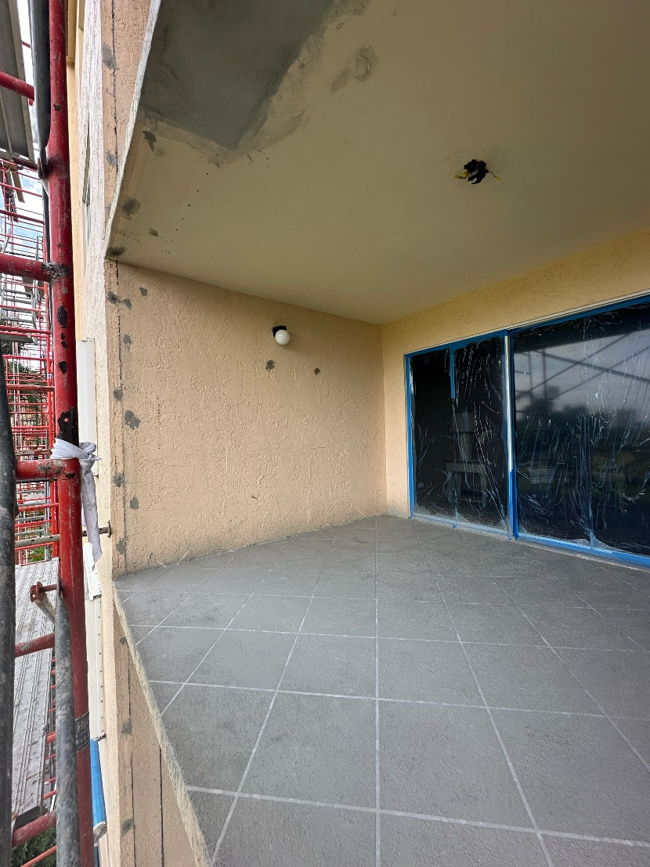
DO WE DO THE BARE MINIMUM TO PASS THE REPORT OR DO WE LOOK AT THE REPAIRS HOLISTICALLY?

